Slide 1


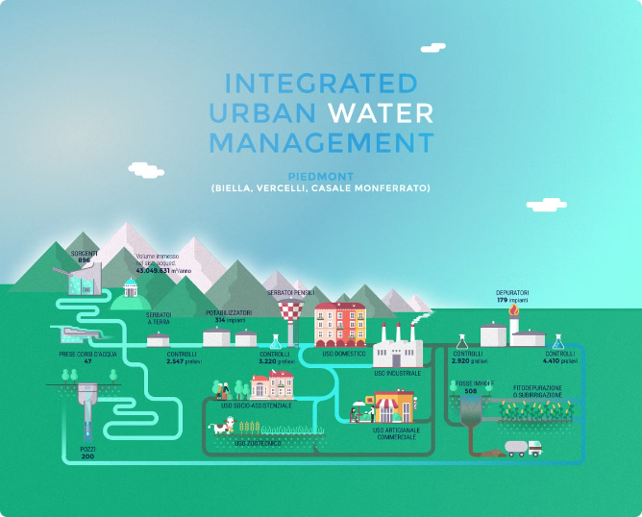




CommUnityCare: A Comprehensive Solution for Water and Waste Management
CommUnityCare is an innovative platform that empowers residents to take an active role in improving their community's water and waste management systems. By providing an intuitive interface for reporting issues and accessing essential services, CommUnityCare aims to enhance the well-being of neighborhoods and foster a stronger sense of civic engagement.
BM Somashekar
Brian M Johnson
Shreyas H S
Harshavardhan K V

Slide 2

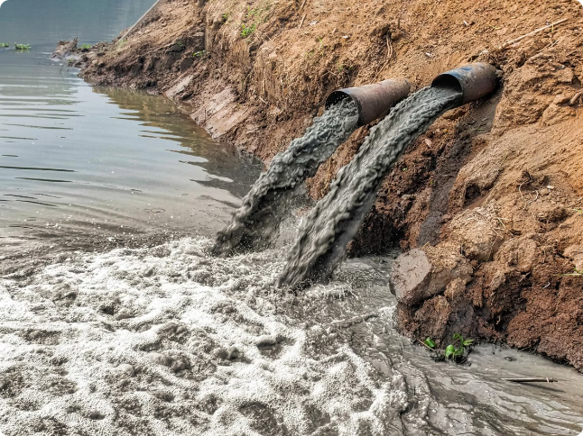
Problem Statement
1
Water Issues
2
Waste Management
Residents often face unresolved water-related problems, such as leaks and shortages, due to the lack of a straightforward mechanism for reporting these issues to government representatives.
Similarly, waste-related issues remain unaddressed due to inefficient reporting and handling systems.
3
Community Impact
These problems negatively impact the quality of life, causing health hazards and resource wastage.

Slide 3
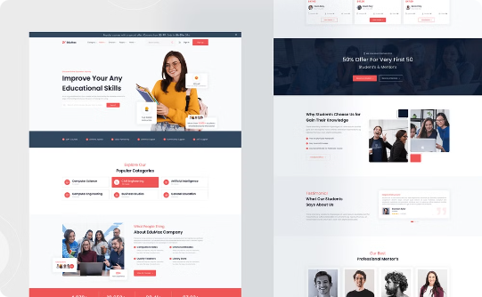
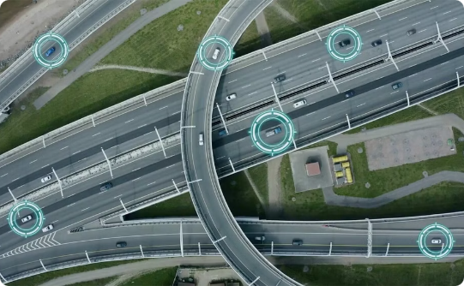
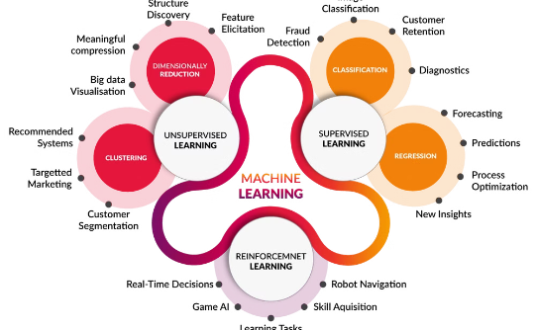
Solution Summary
CommUnityCare Platform
Real-Time Mapping and Alerts
Advanced Technologies
An intuitive web platform that allows residents to report water and waste issues by uploading pictures and descriptions.
Integration of Google Maps for mapping, sensors for real-time leak detection, and machine learning for problem clustering and analysis.
Issues are mapped and alerts are sent to government officials for prompt action.

Slide 4
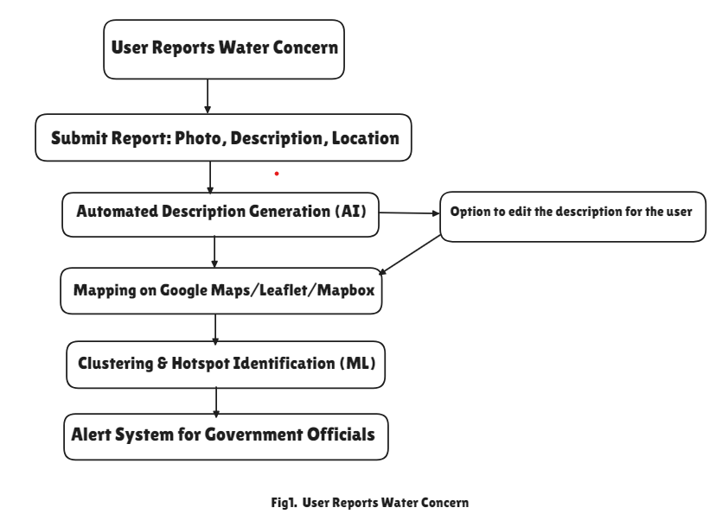
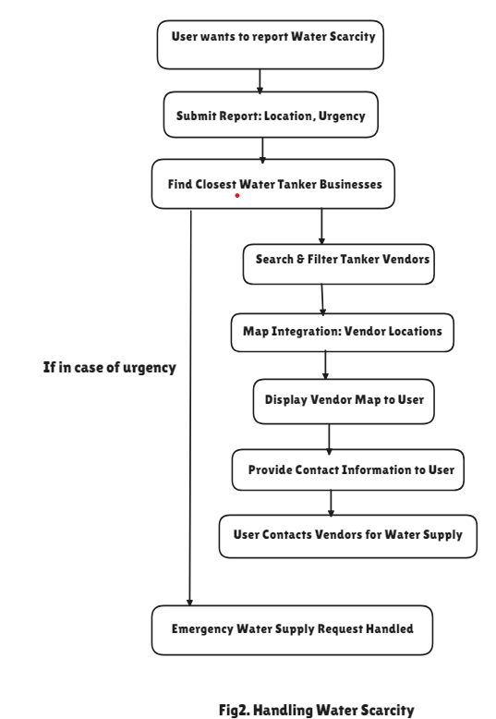
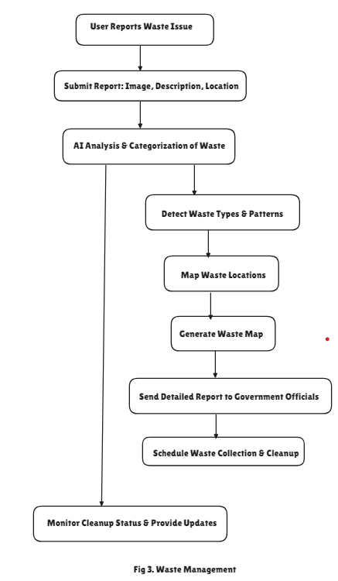
FLOW CHART

Slide 5

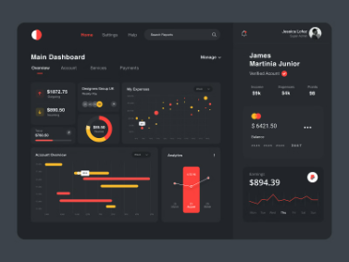
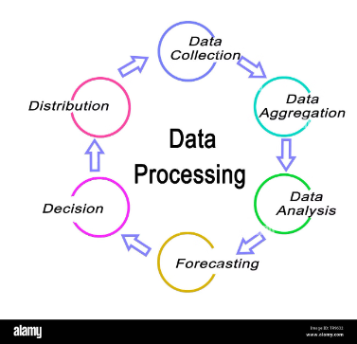
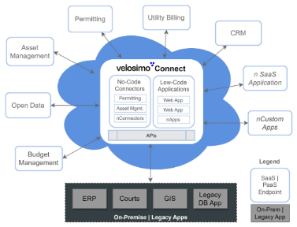
Detailed Approach - Architecture
System Overview
Frontend
Integration
The CommUnityCare platform consists of a user-friendly web frontend, a powerful backend for data processing and analysis, a comprehensive database, and seamless integration with various external services.
The intuitive web interface allows residents to easily report water and waste issues, with the ability to upload photos and descriptions.
Backend
The platform integrates with mapping services, government databases, and local water tanker businesses to provide a comprehensive solution.
The backend handles data processing, natural language processing for keyword extraction, and machine learning algorithms for problem clustering and analysis.

Slide 6
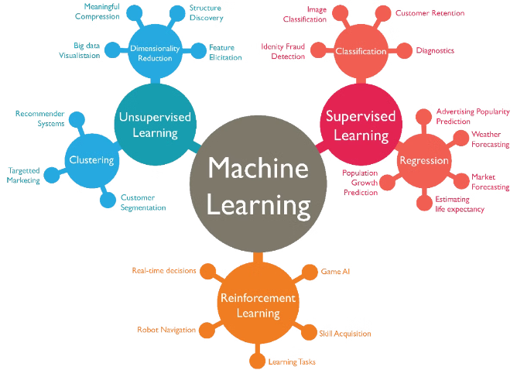
Detailed Approach - Algorithms
1
Keyword Extraction
Natural language processing algorithms are used to extract relevant keywords from user reports, enabling smart categorization and analysis of the issues.
2
Clustering
Machine learning algorithms group similar issues together, allowing for the identification of problem hotspots and the efficient allocation of resources.
3
Leak Detection
IoT sensors are integrated to provide real-time monitoring and alerting for water leaks, enabling a proactive approach to addressing these issues.
4
Image Analysis
Advanced AI models are employed to analyze uploaded photos, verifying the reported issues and providing additional insights.

Slide 7



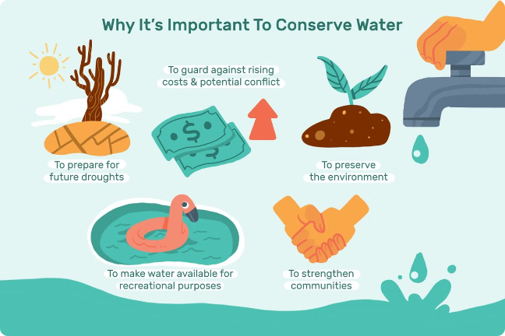


Impact Assessment
Community Benefits
Government Efficiency
Improved problem reporting and resolution, leading to better water and waste management, and a healthier, cleaner community.
Enhanced coordination and faster response times, enabling more effective resource allocation and problem-solving.
Business Opportunities
Societal Implications
Potential for partnerships with local water tanker businesses and tech companies, driving economic growth and innovation.
Reduced resource wastage, improved quality of life, and a more sustainable future for the community.

Slide 8


Monetization Strategy
Subscription Model
Ad Revenue
Partnerships
Government agencies and local businesses could subscribe to the CommUnityCare platform, gaining access to detailed reports and analytics to improve their operations and decision-making.
Local businesses, such as water tanker services, could advertise on the platform, leveraging the targeted audience and the platform's visibility within the community.
Collaborating with technology companies could unlock opportunities for advanced features, services, and revenue sharing, further strengthening the platform's capabilities and financial sustainability.

Slide 9
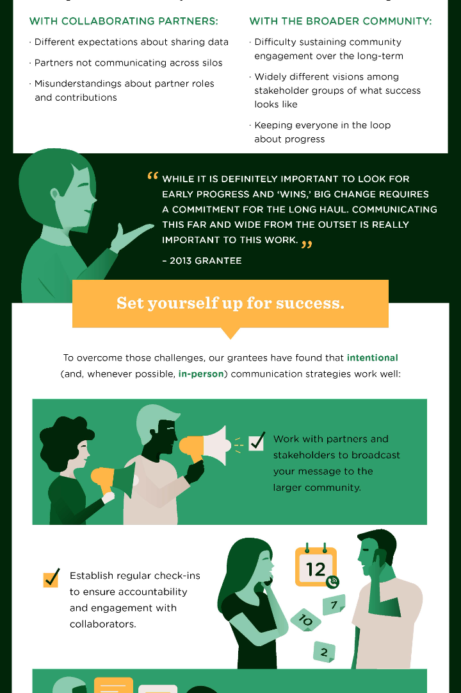
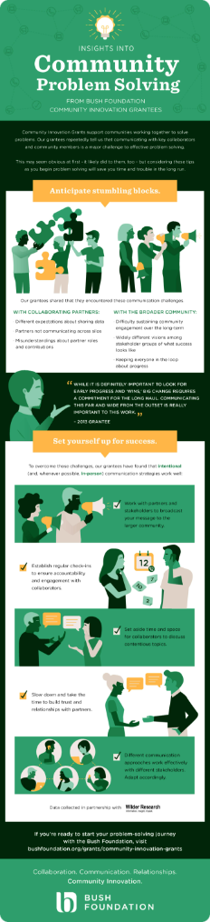



Conclusion
Recap
CommUnityCare provides an innovative solution to address the unresolved water and waste management issues affecting communities, empowering residents and enhancing overall well-being.
Key Benefits
Improved quality of life for residents, more efficient resource management for the government, and new business opportunities for local companies.
Next Steps
Prototyping the platform, securing partnerships, and encouraging stakeholder support to drive the development and implementation of this transformative community-focused initiative.

Slide 10
